Slide 1


Department of Information Technology V R Siddhartha Engineering College
Audio Sentiment Detection Through Hybrid Models and Real-time Analysis
B.Tech in Information Technology
EPICS Project Review Presentation
Presented by
Ch.Teja Sahithi (218W1A1206)
T. Kushal Chakravarthy(218W1A1260)
K. Praneeth (218W1A1224)
Under the guidance of
Dr.M.Suneetha,Professor

Slide 2

Problem Statement
Given an audio input the problem is to create a sentiment analysis solution that can analyze the input and accurately classify the sentiments expressed in the audio as either positive or negative.

Slide 3
Objectives
To create an intuitive and user-friendly interface using react for the frontend and Flask for backend .
To design the system for binary classification, categorizing sentiments as either positive or negative.

Slide 4
Outcomes
Enhanced User Experience:Users will find it easy and enjoyable to interact with the system, leading to an enhanced overall experience.
Enhanced Customer Understanding:Businesses can gain a better understanding of customer sentiments allowing them to tailor products or services accordingly.

Slide 5
Literature Review
Title & Publication Details (Journal) | Model/Techniques used | Purpose and evaluation metrics | Remarks
A deep learning‑based model using hybrid feature extraction approach for consumer sentiment analysis, Gagandeep Kaur,Amit Sharma, Springer January 2023 | A hybrid method comprising review-related features and aspect-related features has been introduced for constructing the distinctive hybrid feature vector corresponding to each review. The sentiment classification is performed using the deep learning classifier LSTM. | The model achieves the average precision, average recall, and average F1-score of 95.9%,94.46%, 91.63%, and 92.81%, respectively. | Reason for the sentiment is not mentioned.
Deep-Sentiment: An Effective Deep Sentiment Analysis Using a Decision-Based Recurrent Neural Network (D-RNN), Putta Durga And Deepthi Godavarthi,IEEE Journal October 2023 | The proposed approach is an integrated model combining pre-trained model BERT-large-cased (BLC) for training the dataset. Stochastic Gradient Descent (SGD) is the optimized algorithm used.The next step is the combination of pre-processing techniques . The next step focused on BoW and Word2Vec.The deep sentiment analysis (DSA) based classification is used. | The model achieves the accuracy,average precision, average recall, and average F1-score of 95.9%, 95.4%, 97.18%, and 96.28%, respectively. | There is a risk of overfitting and the process is resource intensive.
Sentiment and Context-Aware Hybrid DNN With Attention for Text Sentiment Classification, Jawad Khan , Niaz Ahmad , Shah Khalid , Farman Ali , Youngmoon Lee,IEEE Journal March 2023 | A context-aware hybrid DNN model. Uses bidirectional encoder representation from transformers to produce sentiment-enhancedword embeddings.After that, the proposed approach adapts the BiLSTM. Finally, CNN is utilized to reduce the dimensionality of feature space and extract the local key features for sentiment analysis | The model achieves the accuracy,average precision, average recall, and average F1-score of 93.9%, 93.2%, and 93.5%,93.5% respectively. | While transformers capture contextual information, they may still have limitations in understanding broader context and world knowledge, which can impact sentiment analysis accuracy.

Slide 6
Title & Publication Details | Model/Techniques used | Purpose and evaluation metrics | Remarks
Aspect Based Twitter Sentiment Analysis on Vaccination and Vaccine Types in COVID-19 Pandemic With Deep Learning Irfan Aygün , Buket Kaya, and Mehmet Kaya,IEEE Journal,2022 | various models and techniques for sentiment analysis. The study conducted aspect-based sentiment analysis for different countries and used two datasets in English and Turkish with 928,402 different vaccine-focused tweets. In the classification of tweets, 4 different aspects (policy, health, media, and other) and 4 different BERT models were used | The model achieves the average precision, average recall, and average F1-score of 91.29%,90.46%, 89.63%, and 92.81%, respectively. | There is a need for proper handling of tweet content as the tweets used in the study are not shared openly in accordance with Twitter data usage rules.
HunEmBERT: A Fine-Tuned BERT-Model for Classifying Sentiment and Emotion in Political Communication ISTVÁN ÜVEGES AND ORSOLYA RING ,IEEE Access ,2023 | The "HunEmBERT" paper used a fine-tuned BERT model for classifying sentiment and emotion in political communication. The study employed NLTK for classification, a supervised KNN clustering algorithm, and NLP for raw Twitter post analysis. Additionally, the paper utilized a pre-processing technique to categorize tweets into positive, negative, and neutral sentiment types | The model achieves the accuracy,average precision, average recall, and average F1-score of90.9%, 95.34%, 92.18%, and 96.28%, respectively. | Clauses which were not exclusively annotated with a single label during the manual annotation are removed from training data.
Sentiment Analysis of Animated Online Education Texts Using Long Short-Term Memory Networks in the Context of the Internet of Things JUN MAOZHE QIANAnd TERRY LUCAS , IEEE Access , 2023 | The paper used Long Short-Term Memory (LSTM) networks for sentiment analysis of animated online education texts. The study focused on the emotion evoked by the text in the learning resources and analyzed their titles and descriptions contained in their metadata. The paper also utilized NLTK for classification and NLP for raw Twitter post analysis | The model achieves the accuracy,average precision, average recall, and average F1-score of 96.9%, 95.2%, and 95.5%,91.5% respectively. | In real time it is very time consuming to collect and integrate data from different devices.

Slide 7
Challenges that could be Overcome by Our Proposed Project
Real-Time Processing:
-The model processes text and audio inputs instantly, providing sentiment prediction.

Slide 8
Dataset Description
IMDB dataset :
- 50001 rows
- 2 columns(review,sentiment)
- Positive,Negative are the labels
Software Requirements
Jupyter Notebook
NLTK
Sklearn
Keras
Pandas
Tenserflow

Slide 9
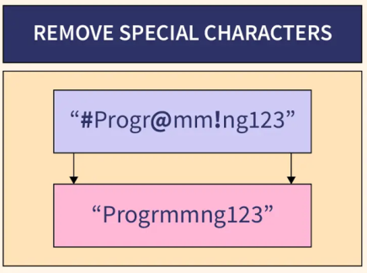

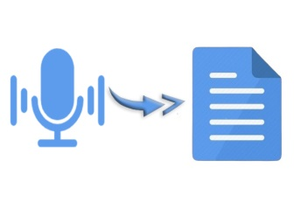



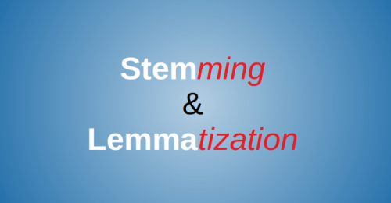
Preprocessing
CountVectorizer
Word2vec
TF-IDF
Lowercase Conversion
Naïve Bayes
CNN+LSTM
CNN+SVM
TF-IDF+Naïve Bayes

Slide 10
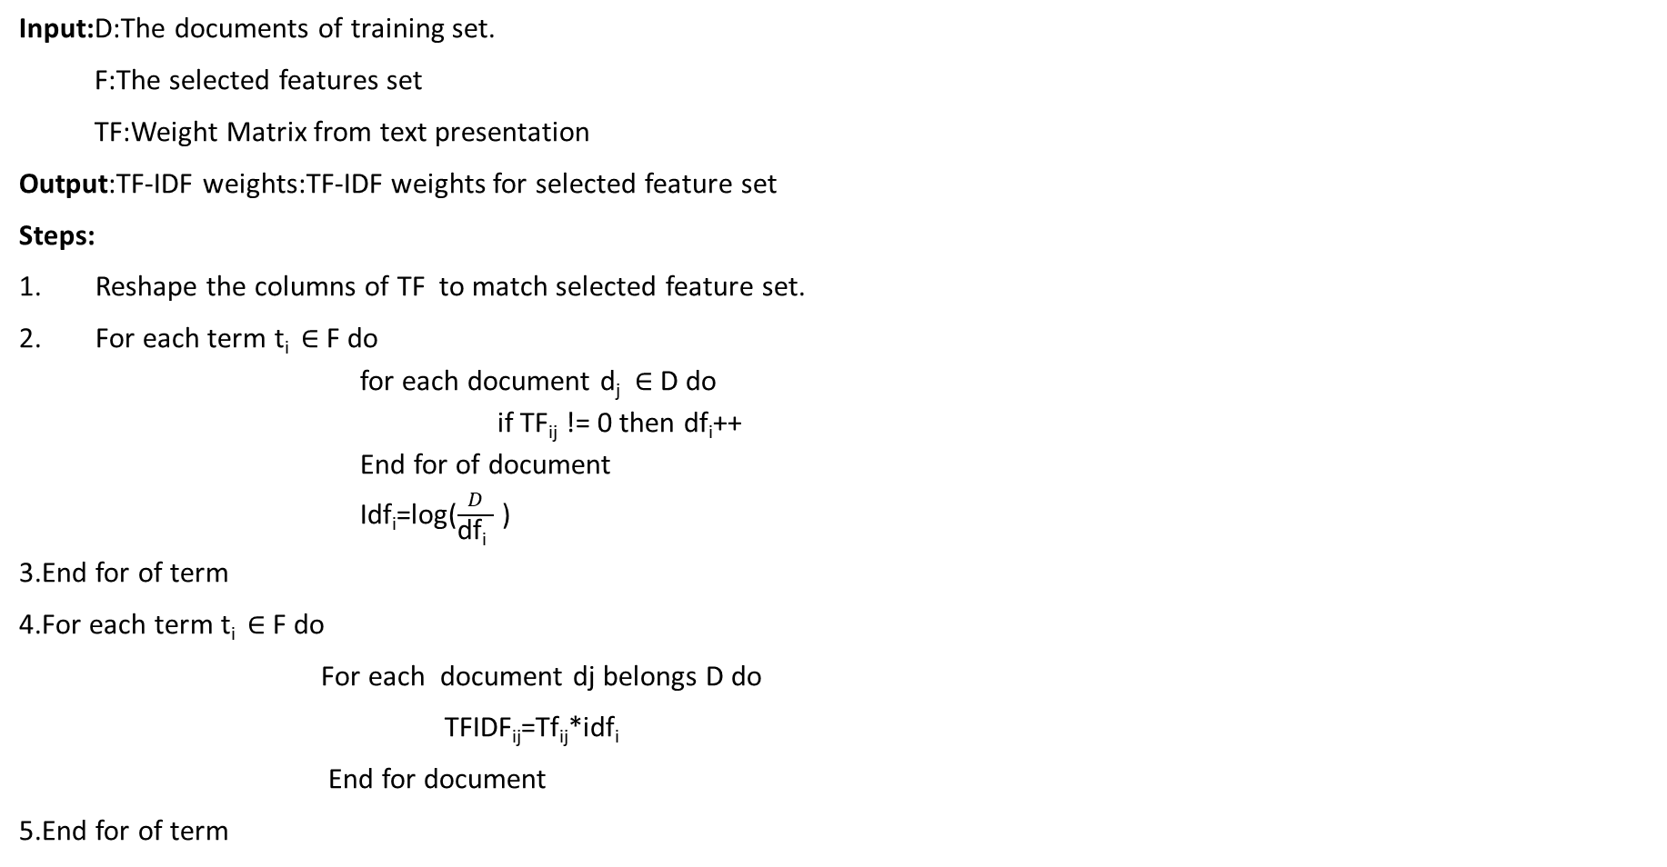
Algorithm for TF-IDF+Naïve Bayes
Input:D:The documents of training set.
F:The selected features set
TF:Weight Matrix from text presentation
Output:TF-IDF weights:TF-IDF weights for selected feature set
Steps:
Reshape the columns of TF to match selected feature set.
For each term t_{i} ∈ F do
for each document d_{j} ∈ D do
if TF_{ij} != 0 then df_{i}++
End for of document
Idf_{i}=log($\frac{D}{\text{df}\text{i} }$ )
3.End for of term
4.For each term t_{i} ∈ F do
For each document dj belongs D do
TFIDF_{ij}=Tf_{ij}*idf_{i}
End for document
5.End for of term

Slide 11
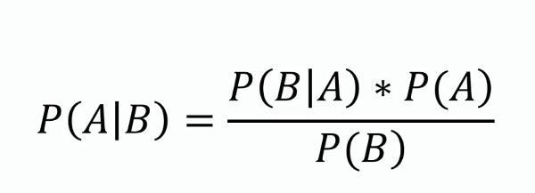

Naïve Bayes Algorithm
Input:
Training datset T
F=(f1,f2,f3,fn)//value of predicted value
Output:
A set of predicted values.
Steps:
1.Read the training dataset T;
2.Repeat
Calculate the probability of fi using the naïve bayes equation in each class.
Until the probability of all predictor variables(f1,f2------fn) has been calculated.
3.Calulate likelihood of each class.
4. s(c)=max(class_{i}(0),class_{i}(1))

Slide 12
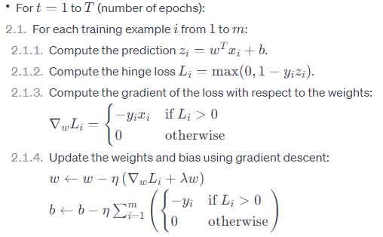


Algorithm for CNN+SVM
Input:Feature matrix X and test vector y with labels 1 or 0
Output:Weights (w) and bias (b) defining the decision boundary.
Steps:
Initialize weight and bias
W <-zeros(n)
B<- n
2.Training loop:
3. Return the learned weights (w) and bias (b).
Flatten layer
Dense layer
Embedding layer
Convolution layer
(Kernel=3,filters=32)
SVM Algorithm

Slide 13
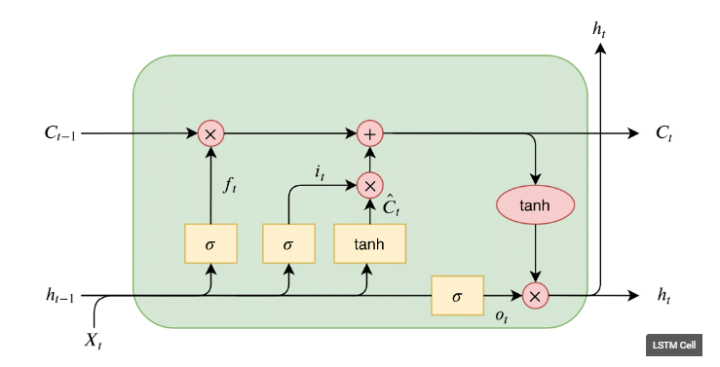

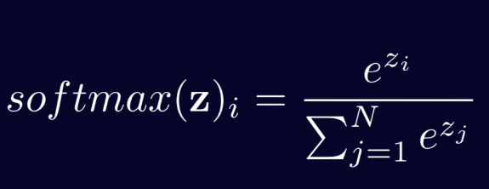
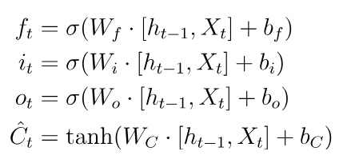

Algorithm For CNN+LSTM
The three gates, forget, input, and output, can be seen on the figure above as f_{t}, i_{t}, and o_{t}.
The forget gate tells the cell which information to “forget” or throw away from the internal cell state.
The input gate tells the cell which new information to store in the internal cell state.
The output gate is then what the cell outputs, this is a filtered version of the internal cell state.

Slide 14
Implementation Steps
Preprocess the data by removing special characters,stop words,changing text to lower case.
Do tokenization ,lemmatization,padding on that data.
Divide the data into 80% training and 20% testing.
TF-IDF+Naïve Bayes:
-Create a TF-IDF vector by calculating frequencies for each aspect term.
-Create a pipeline to implement the created vector in a TF-IDF+Naïve Bayes model.
Naïve Bayes:
-Vectorize the preprocessed text using CountVectorizer.
-Train the Naive Bayes model and test the data.
CNN+SVM:
-Build the model using CNN
-Do feature extraction using SVM
CNN+LSTM:
-Initialize Word2Vec Model and Create Word Embeddings.
-Add a 1D convolutional and LSTM layer to the model.

Slide 15

Output

Slide 16
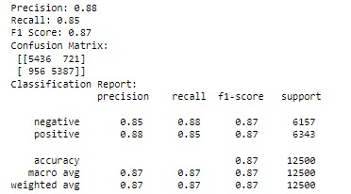
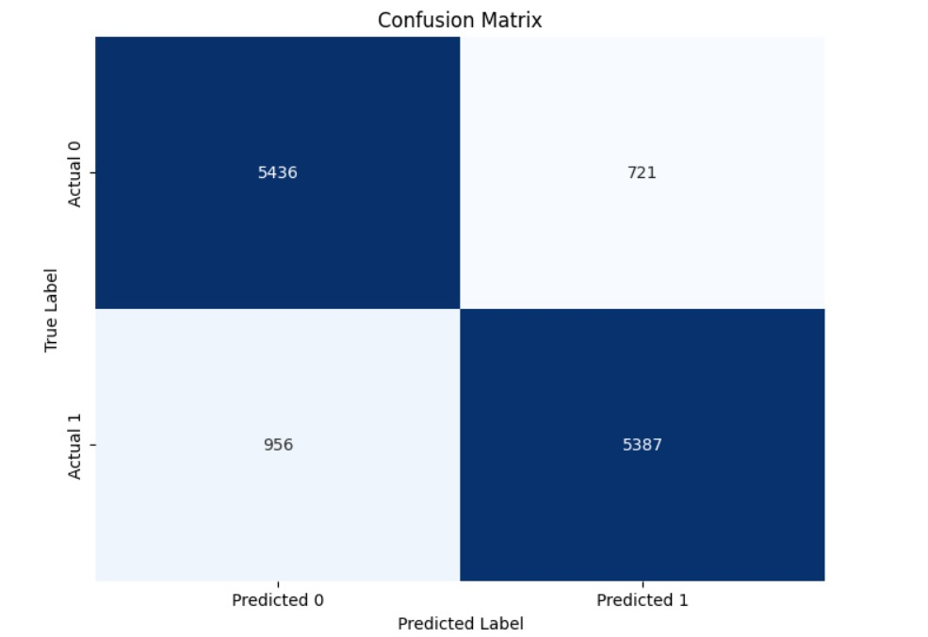
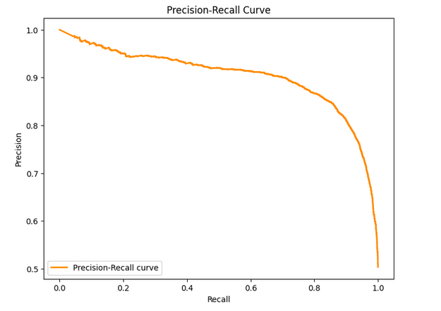
Results for TF-IDF+Naïve Bayes

Slide 17
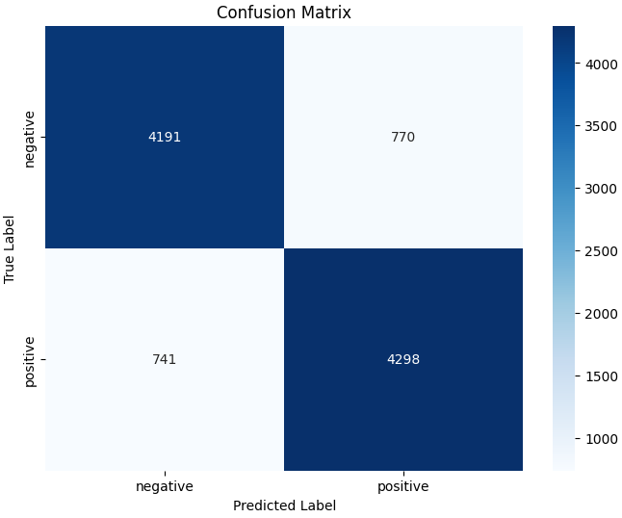
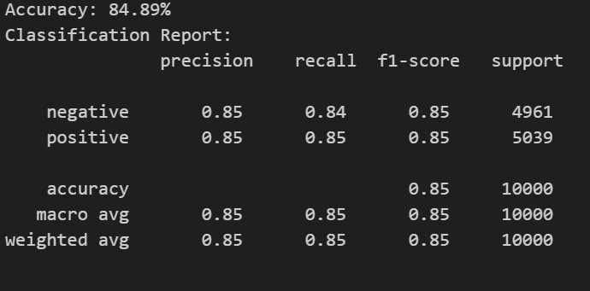
Results for Naïve Bayes

Slide 18
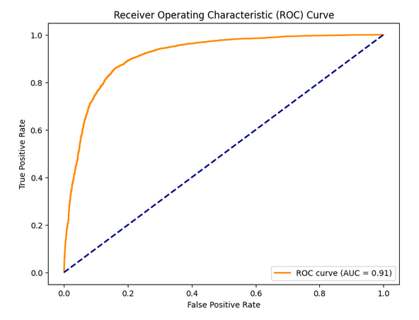

Slide 19
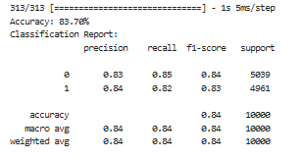
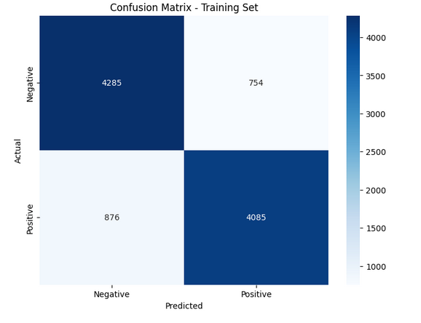
Results for CNN+SVM

Slide 20
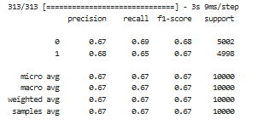
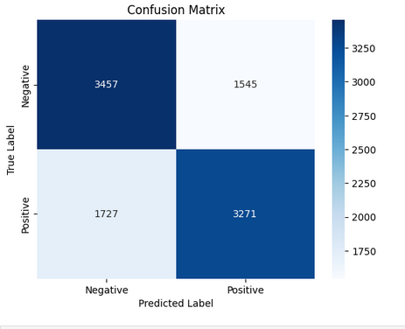

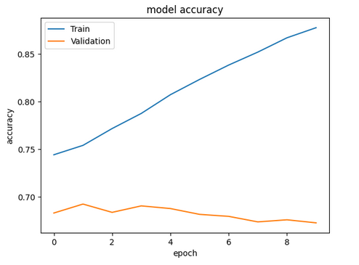
Results for CNN+LSTM

Slide 21
Comparitive Analysis
Algorithm | Dataset | Accuracy
TF-IDF+Naïve Bayes | IMDB | 86.584%
Naïve Bayes | IMDB | 84.89%
CNN+SVM | IMDB | 83.70%
CNN+LSTM | IMDB | 67%

Slide 22
Future Scope
Generating sentiment analysis report.
Add multi-lingual support.
To create a chatbot that can analyze the sentiment and give appropriate recommendations.

Slide 23
Field Work

Slide 24
Societal Applications
Social media monitoring
Customer support ticket analysis
Brand monitoring and reputation management
Listen to voice of the customer (VoC)
Listen to voice of the employee
Product analysis
Market research and competitive research

Slide 25
References
Gagandeep Kaur and Amit Sharma A deep learning-based model using hybrid feature extraction approach for consumer sentiment analysis,
Alamanda MS. Aspect-based sentiment analysis search engine for social media data. CSI Trans ICT. 2020;8(2):193–7.
Understanding TF-IDF in NLP.. TF-IDF, short for Term… | by Gaurav Rajesh Sahani | Analytics Vidhya | Medium
LSTMs Explained: A Complete, Technically Accurate, Conceptual Guide with Keras | by Ryan T. J. J. | Analytics Vidhya | Medium

